Slide 1
SOFTWARE ENGINEERING
PROJECT THREE(3)

Slide 2
GROUP TWO MEMBERS
MICHELLE OWUSU-10957340
GEORGE ANANE NYARKO-10947340
SANDRA DERY-KUUZUME -10986424
MENSAH NYANYO HUBERT – 10976127

Slide 3
Design and Development of a Database Driven Web and Mobile Application

Slide 4
WHO WE ARE
We are group two. a group of enthusiastic COMPUTER engineering students from THE UNIVERSITY OF GHANA, LEGON. We have come together with a shared passion for tackling challenges IN THE SCHOOL OF ENGINEERING SCIENCES and creating innovative solutions.
Throughout this project, we aim to apply the knowledge we've gained in our studies and put our skills into practice. We are excited about this opportunity to learn, collaborate, and make a meaningful impact in the field of DESIGNING A dataBAse-driven WEB PAGE AND A MOBILE APPLICATION.

Slide 5
INTRODUCTION
The project is a database-driven web and mobile application designed to improve student information management in the School of Engineering Sciences at the University of Ghana.
It utilizes technologies like React for the front end, Spring Boot for the back end, and Flutter for the mobile app.
The primary goals are to enhance user experience, increase administrative efficiency, and ensure accurate and up-to-date student data.

Slide 6
ABSTRACT
The project is a groundbreaking database-driven web and mobile application that transforms student information management in the Engineering School.
It offers a user-friendly interface and seamless integration between the front end, back end, and mobile app. The application enables student registration, information management, and comprehensive dashboards.
With the use of React, Spring Boot, and Flutter, it ensures scalability, maintainability, and security, catering to the needs of modern educational environments.

Slide 7
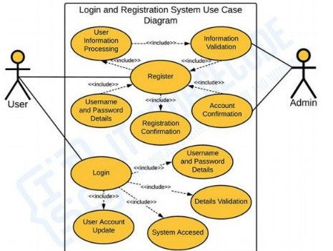
SOFTWARE SYTEM MODELLING
USE CASE DIAGRAM

Slide 8
PROBLEM STATEMENT
The combined Mobile System App and SES React Project aim to address the inefficiencies and errors in student information management at the School of Engineering Sciences, University of Ghana..
The applications target administrators, faculty, staff, and students, offering user authentication, student data management, and a comprehensive dashboard.
THE APPLICATION WAS Built using Flutter for mobile, React for the web AND SPRINGBOOT TO LINK THE DATABASE TO THE BACKEND, both applications ensure security and privacy with a PostgreSQL database.

Slide 9
PROBLEM STATEMENT
They also focus on adhering to platform guidelines, scalability, and performance optimization, supported by thorough testing and comprehensive documentation.
The project aims to streamline student information management, enhance administrative processes, and improve the overall student experience within the ENGINEERING SCHOOL.

Slide 10
REQUIREMENTS.
THIS IS THE PHASE WHERE WE DID SURVEYS, ASKED A NUMBER OF STUDENTS AND STAFF IN THE ENGINEERING SCHOOL RELEVANT QUESTIONS AS TO WHETHER THEY NEED SUCH AN APPLICATION AND HOW THEY EXPECT IT TO BE LIKE.
FROM THE SURVEY AND FEEDBACKS WE HAD FROM THE CLIENTS(STUDENTS AND STAFF), WE WERE ABLE TO DEDUCE OUR REQUIREMENTS INTO TWO PARTS WHICH ARE THE FUNCTIONAL AND NON-FUNCTIONAL REQUIREMENTS.

Slide 11
THE FUNCTIONAL REQUIREMENTS
THE FUNCTIONAL REQUIREMENTS WE DEDUCED FROM THE FEEDBACK OF THE SURVEY ARE :
1. User Authentication: Users should be able to securely authenticate themselves to access the application USING THEIR RESPECTIVE ID AND PIN
2. Student Registration: New students should be able to register and create their profiles.
3. Student Information Management: The application should allow administrators, faculty, and staff to manage student information, including personal details, contact information, academic records, and attendance.

Slide 12
CONT’D
4. Comprehensive Dashboard: A centralized dashboard should provide an overview of student information, upcoming events, and relevant notifications.
5. API Development: Design and develop APIs to facilitate communication between the frontend and backend components of the application.
6. Data Validation: Implement validation mechanisms to ensure the integrity and accuracy of the data entered or retrieved from the database.

Slide 13
NON FUNCTIONAL REQUIREMENTS
1. User-Friendly Interface: The application should have an intuitive and visually appealing interface for easy navigation and interaction.
2. Performance: The application should be optimized for performance to ensure smooth user experience even with a large amount of data.
3. Scalability: The system should be designed to handle a growing number of users and data records.

Slide 14
SOFTWARE PROCESSES
THERE WERE A NUMBER OF PROCESSES WE WENT THROUGH TO BE ABLE TO DEVELOPN AN EFFICIENT AND RELIABLE SOFTWARE. THE PROCESSES ARE ;
REQUIREMENT PHASE: THIS IS WHERE INFORMATION FROM THE CLIENT ABOUT THE SOFTWARE IS GATHERED AND CAPTURED .
SPECIFICATION: THIS IS WHERE A COMPREHENSIVE EXPLANATION IS PROVIDED ON THE REQUIREMENT TO FULFILL USER EXPECTATION
DESIGN PHASE: THIS IS WHERE A GRAPHICAL REPRESENTATION OF THE SOFTWARE IS MADE

Slide 15
CONT’D
IMPLEMENTATION PHASE: THIS IS WHERE CODE IS WRITTEN AND IMPLEMENTED USING VARIOUS PROGRAMMING TOOLS AND LANGUAGES LIKE FLUTTER, REACT, SQL ETC.
INTEGRATION: THIS IS WHERE THE PROJECT IS CORDINATED AND PROJECT RESOURCES ARE DIRECTED TO MEET THE OBJECTIVES OF THE PROJECT PLAN.
MAINTENANCE: THIS IS WHERE CHANGES ARE DONE TO THE SOFTWARE IF ANY.
RETIREMENT: THIS IS WHERE THE SOFTWARE BECOMES UN-MAINTAINABLE DUE TO A DRASTIC CHANGE IN A NEWLY PROPOSED SOFTWARE

Slide 16
SOFTWARE SYSTEM ARCHITECTURE
Layered architecture is like organizing a building with different floors, where each floor has specific functions. We used this architecture because of its abilities such as:
Abstraction and encapsulation mean that each floor hides its internal workings and only provides the necessary information to the next floor. This keeps things simple and reduces dependencies between floors.
Scalability is like adding more floors or changing them according to your needs. If you need new features, you can add a new floor, and if something needs improvement, you can change that floor without affecting others. This flexibility makes the building adaptable to changes and growth.
LAYERED ARCITECTURE

Slide 17
System architecture
- The front end will be developed using React, which will handle the user interface and user interactions.
- React components will be responsible for rendering views, capturing user input, and displaying data from the back end.
- It will interact with the back end through API calls to fetch and update data.
Front end (react)

Slide 18
System architecture
- The back end will be developed using Spring Boot, which will handle the business logic and data processing.
- It will provide a set of RESTful APIs that the front end and mobile app can communicate with.
- The back end will process requests from the front end and interact with the database to retrieve or update data.
- It will enforce security measures such as authentication and authorization to protect sensitive data.
Back end (spring boot)

Slide 19
System architecture
- The mobile app will be developed using Flutter, which will provide a native-like user interface and user experience for mobile devices.
- It will interact with the back end through API calls to retrieve and update data.
- The mobile app will have its own set of screens and components to handle user interactions and data presentation.
Mobile application (flutter)

Slide 20
System architecture
- The database will be PostgreSQL, which will store and manage the application's data.
- It will be responsible for persisting student information, course details, enrollment records, and other relevant data.
- The back end will interact with the database through data access layers which is the SQL queries to perform its operations.
Database (postgresql)

Slide 21
WHY AGILE SOFTWARE MODEL
Agile software model is a risk-driven model
THE PROjECt TEAM AGREED ON USING THIS SOFTWare model because of its numerous advantages which include:
Customer satisfaction
Faster delivery
Improved quality
Collaborative teamwork
Flexibilty and adaptibilty

Slide 22
System design and implementation
Codes were written in several programming languages like (react, flutter, postgresql) to develop a full working mobile application.

Slide 23
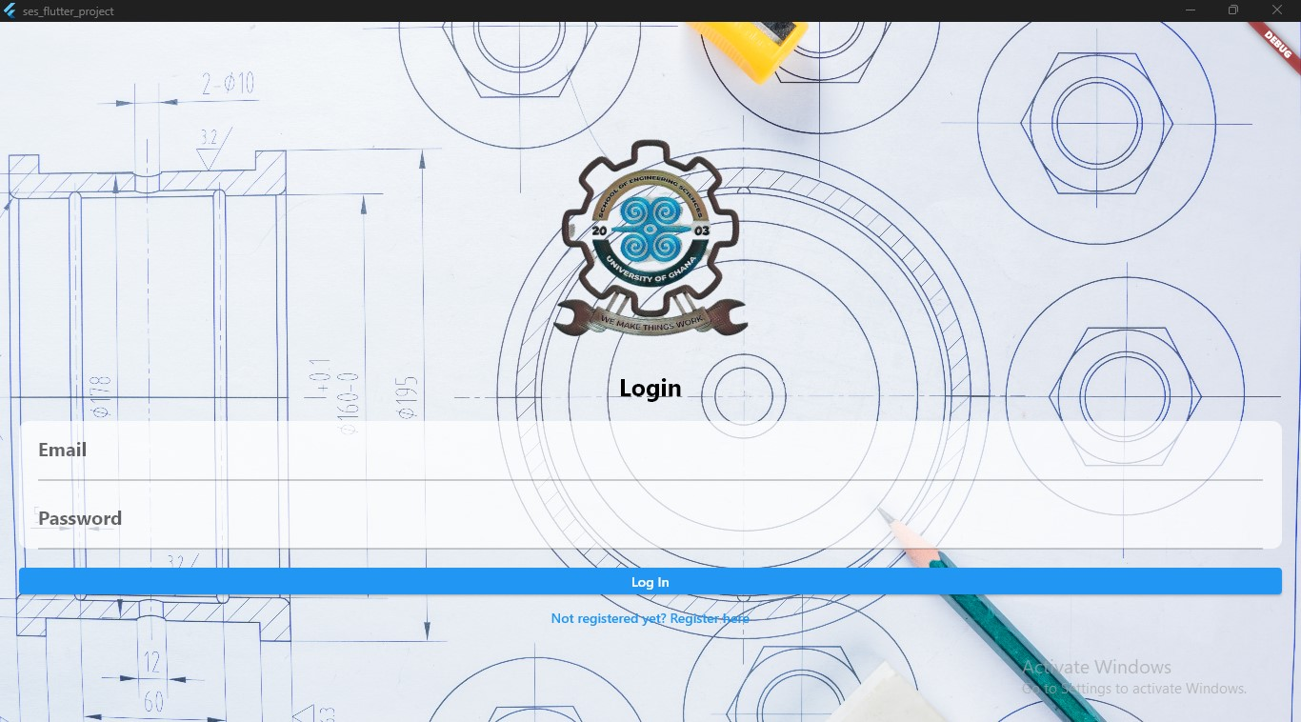
testing
Login page

Slide 24
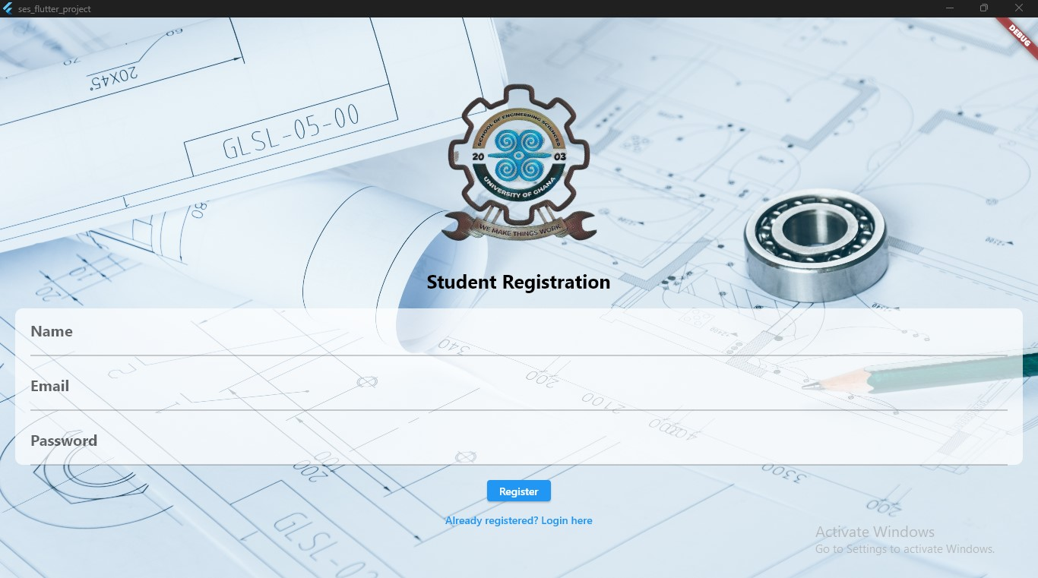
testing
Student registration page

Slide 25
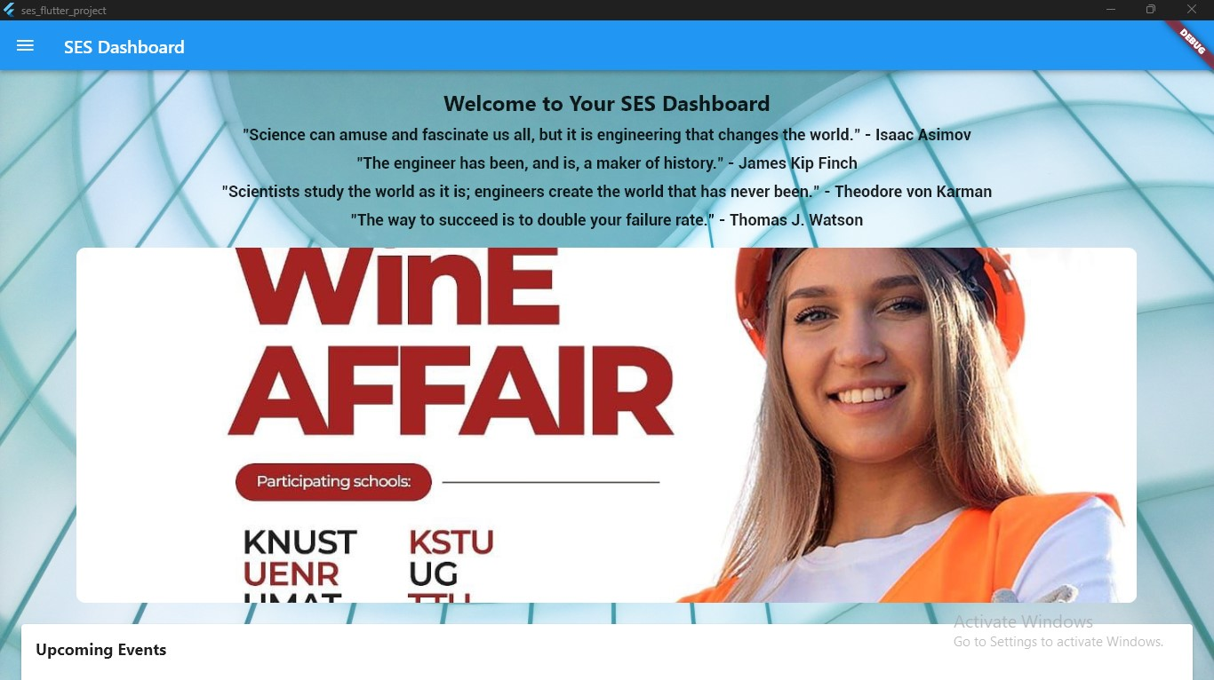
testing
dashboard

Slide 26
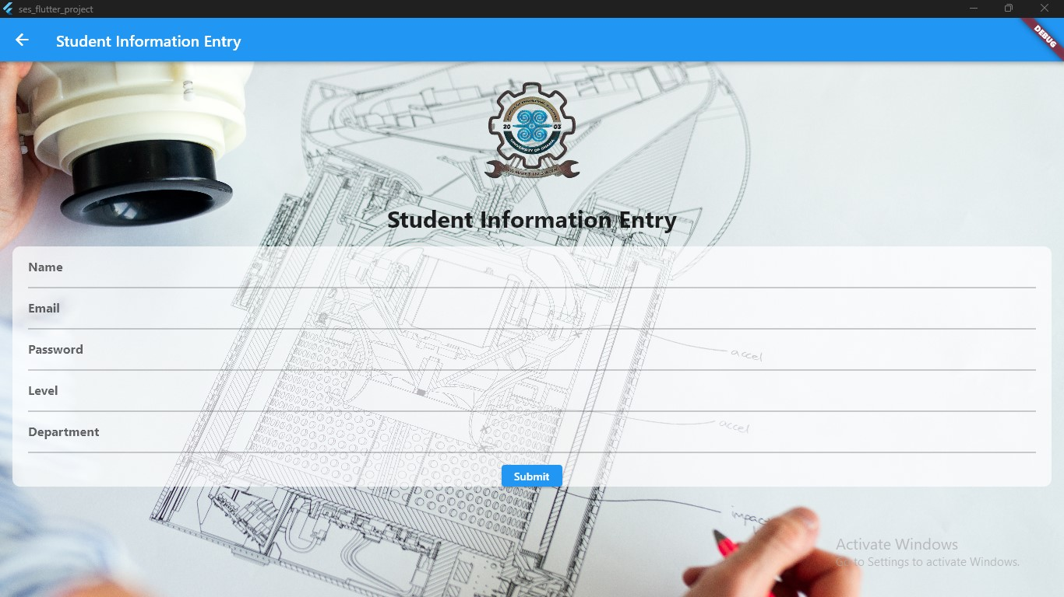
testing
Student info entry page

Slide 27
SOFTWARE PROJECT MANAGEMENT
Project planning and tackling
Risk management
Risk management is a crucial aspect of software process management. The project team will identify potential risks that may impact the project's success and develop strategies to mitigate them.
Common risks for the project may include technical challenges, scope creep, resource constraints, security vulnerabilities, and changes in requirements.
The project will be planned using Scrum methodologies, with clear objectives defined for each sprint.
The team will create a project timeline with estimated sprint durations, taking into account the complexity of tasks and resource availability.

Slide 28
SOFTWARE PROJECT MANAGEMENT
Project planning and tackling
Risk management
Regular risk assessment and contingency planning will be conducted throughout the project to minimize the impact of potential risks on project timelines and deliverables.
Project progress will be tracked using Scrum boards, such as Kanban boards, to visualize tasks and their status, facilitating efficient task management.

Slide 29
Conclusion
the database-driven web and mobile application project presents a comprehensive solution for student information management.
By harnessing the power of React, Spring Boot, and Flutter, the application offers an intuitive and efficient platform to manage student data.
Through thorough testing and adherence to software engineering principles, the project delivers a robust and user-friendly system that enhances the student experience and improves administrative processes in the engineering school.

Slide 30
Thank you!!
Any questions??

